Slide 1
Chemical Bonding

Slide 2
ELECTRONIC THEORY OF VALENCY :
The combining tendency of atoms was explained by Kossel and Lewis (1916) through their theory called electronic theory of valency. The main postulates of this theory are,
(i) The tendency of an atom to take part in chemical combination is determined by the number of valence electrons. The valence electrons are the electrons in the outermost shell of the atom.
(ii) The atoms combine by mutual sharing or by transfer of one or more electrons. In doing so, each combining atom acquires stable noble gas electronic configuration having 8 electrons in its outermost shell. This is called octet rule.

Slide 3
ELECTRONIC THEORY OF VALENCY :
(iii) The number of electrons which an atom loses, gains or mutually shares to attain the nearest noble gas configuration is called its valency. For example, Li, Be, B and C having respectively 1, 2, 3 and 4 electrons, have valency of 1, 2, 3 and 4. The elements N, O, F and Ne having 5, 6, 7 and 8 electrons in their outermost shell show valency of 3, 2, 1 and 0 respectively
Thus, "the common valency of an element is either equal to the number of valence electrons, or it is equal to 8 minus the number of valence electrons."

Slide 4
In the octet rule:
To achieve a valence octet, some atoms give away electrons, others will accept or take electrons, and others share electrons.
These different modes of achieving a valence octet lead to different kinds of compounds.

Slide 5
Different types of Bonding
Result of octet rule: Atoms bond together so that each atom acquires an electron configuration the same as that of the noble gas nearest to, it in atomic number
An atom that gains electrons becomes an anion
An atom that loses electrons becomes a cation
The attraction of anions and cations leads to the formation of ionic solids
An atom may share electrons with one or more atoms to complete its valence shell; a chemical bond formed by sharing electrons is called a covalent bond
Bonds may be partially ionic or partially covalent; these bonds are called polar covalent bonds

Slide 6
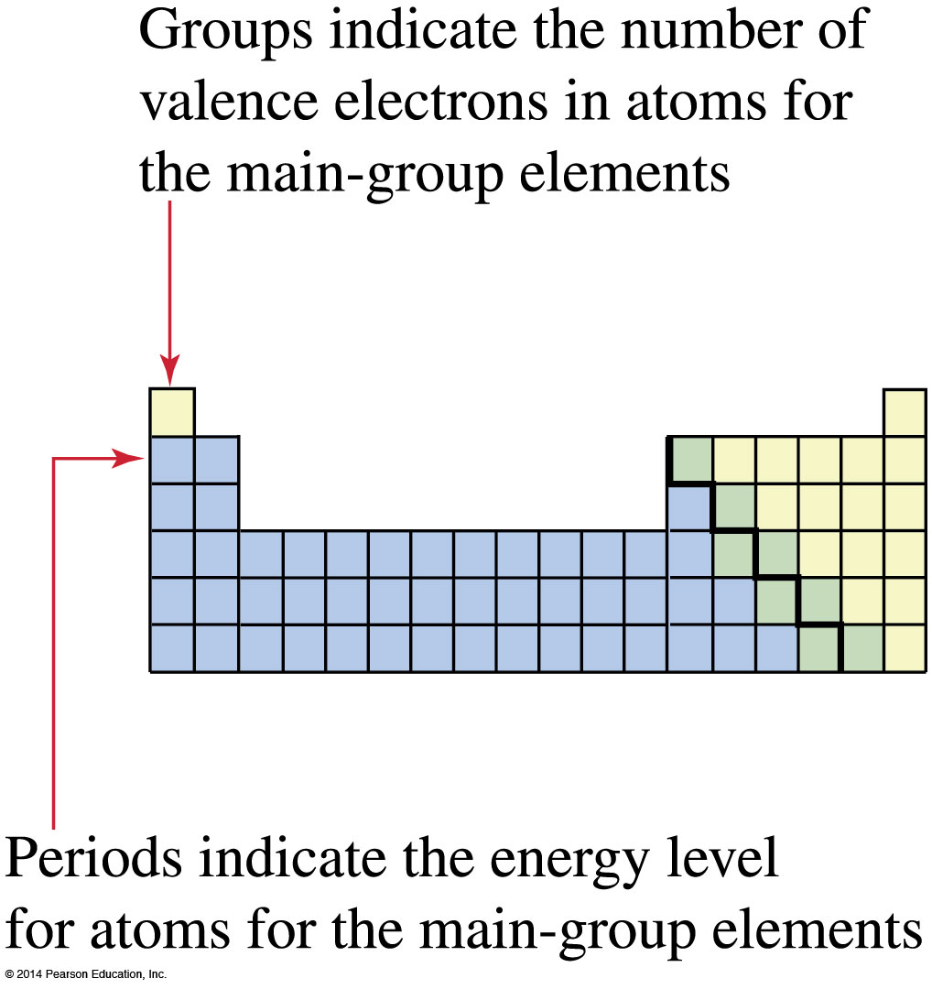
Electron Arrangements and the Octet Rule

Slide 7
Exceptions to the Octet Rule
Molecules containing atoms of Group 13 elements, particularly boron and aluminum
:
6 electrons in the
:
F
:
valence shells of boron
:
:
:
C
l
:
and aluminum
:
:
F
B
:
C
l
A
l
:
:
:
F
:
:
C
l
:
:
:
Boron trifluoride
Aluminum chloride

Slide 8
Exceptions to the Octet Rule
Atoms of third-period elements have 3d orbitals and may expand their valence shells to contain more than 8 electrons
phosphorus may have up to 10

Slide 9
Exceptions to the Octet Rule
Sulfur, another third-period element, forms compounds in which its valence shell contains 8, 10, or 12 electrons

Slide 10
Types of Chemical Bonds
The type of chemical bond developed between the two combining atoms depends upon the way these atoms acquire a stable noble gas configuration.
Elements may combine through any one of the following ways to form stable compounds.
By the transfer of electrons from the atom of an element to the atom or atoms of another. This gives rise to an ionic (or electrovalent) bond.

Slide 11
Types of Chemical Bonds
By mutually sharing the electrons. This gives rise to a covalent bond.
By one-sided sharing of electrons. This gives rise to a coordinate covalent bond.

Slide 12
Ionic Bond
An IONIC BOND is an electrostatic interaction that holds together a positively charged ion (cation) and a negatively charged ion (anion).
In an ionic bond, one atom loses an electron to another atom, thus cations and anions are formed. And, opposites attract.

Slide 13
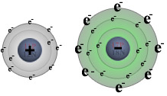
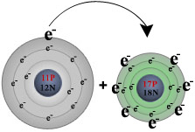
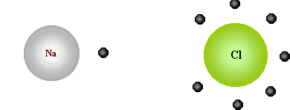
Ionic Bond
Formation of NaCl

Slide 14
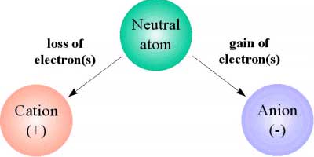
Sodium chloride results from ionic bonding.
In table salt, for example, a valence electron from a sodium atom is transferred to a chlorine atom, forming Na⁺ and Cl─. Because the ions have opposite charges, they are attracted to each other. The loss of a valence electron and the attraction to the atom that took it, happen simultaneously.

Slide 15
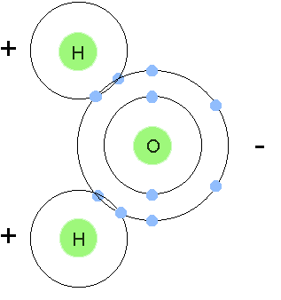
Covalent Bonding
Pairs of e- are shared between 2 non-metal atoms to acquire the electron configuration of a noble gas.

Slide 16
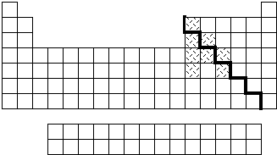
Covalent Bonding
Occurs between nonmetal atoms which need to gain electrons to get a stable octet of electrons or a filled outer shell.
nonmetals

Slide 17
Covalent Bonds
A covalent bond is formed between two atoms (similar or dissimilar) by a mutual sharing of electrons. The shared pairs of electrons are counted towards the stability of both the participating atoms.
A covalent bond is defined as the force of attraction arising due to mutual sharing of electrons between the two atoms. The combining atoms may share one, two or three pairs of electrons.

Slide 18
Covalent Bonds
When the two atoms combine by mutual sharing of electrons, then each of the atoms acquires stable configuration of the nearest noble gas. The compounds formed due to covalent bonding are called covalent compounds.

Slide 19
Covalent Bonds
Covalency
The number of electrons which an atom contributes towards mutual sharing during the formation of a covalent bond is called its covalency in that compound. Thus, the covalency of hydrogen in H₂ (H - H, H H) is one; that of oxygen in O₂ is two (O = O,), and that of nitrogen in N₂ is three (N ≡ N, N N)

Slide 20

Single Covalent Bond
A covalent bond formed by mutual sharing of one pair of electrons is called a single covalent bond, or simply a single bond. A single covalent bond is represented by a small line (−) between the two atoms.

Slide 21
MULTIPLE COVALENT BONDS:
The covalent bonds developed due to mutual sharing of more than one pairs of electrons are termed multiple covalent bonds. These are,
Double covalent bond: The bond formed between two atoms due to the sharing of two electron-pairs is called a double covalent bond or simply a double bond. It is denoted by two small horizontal lines (=) drawn between the two atoms, e.g., O = O, O = C = O etc.
Triple covalent bond: Bond formed due to the sharing of three electron-pairs is called a triple covalent bond or simply a triple bond. Three small horizontal lines between the two atoms denote a triple bond, e.g., N ≡ N, and H − C ≡ C − H (acetylene)

Slide 22
Coordinate Bonds
When, an atom having a complete octet donates a pair of free valence electrons to another atom which is short of two electrons, the resulting bond is known as coordinate bond. Thus both the atoms acquire inert gas configurations.
The atom which donates a pair of electrons is called ‘donor’ and the other atom which accepts the electrons is called ‘acceptor’

Slide 23
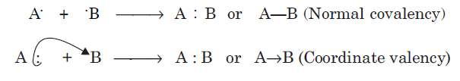
Coordinate covalent bond
The formation of covalent and coordinate bond is illustrated below:
When one atom furnishes both electrons for the formation of a covalent bond as described above, the process is called ‘coordination’.

Slide 24
Coordinate Bonds
The coordinate bond is similar to covalent bond except that both the shared electrons are donated by one atom.
The bond formed when one-sided sharing of electrons take place is called a coordinate bond. Such a bond is also known as dative bond. A coordinate bond is represented by an arrow (→) pointing towards the acceptor atom

Slide 25
Coordinate covalent bond
Since one atom donates an electron pair and the other accepts, the molecule acquires polarity. These bonds, therefore, are also known as ‘semi polar bonds’ or ‘dative bond’.

Slide 26
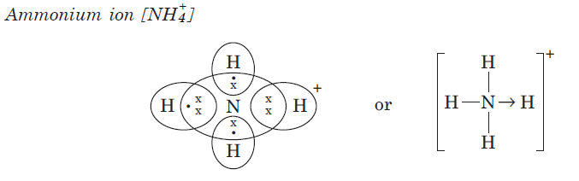
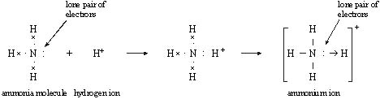
Formation of Coordinate Bond During the Formation of a Molecule or Molecular ion
Ex. Formation of ammonium (NH₄⁺) ion. During the formation of ammonium ion, nitrogen is the donor atom, while H⁺ is the acceptor ion as shown below.
Ammonium ion formation
H

Slide 27
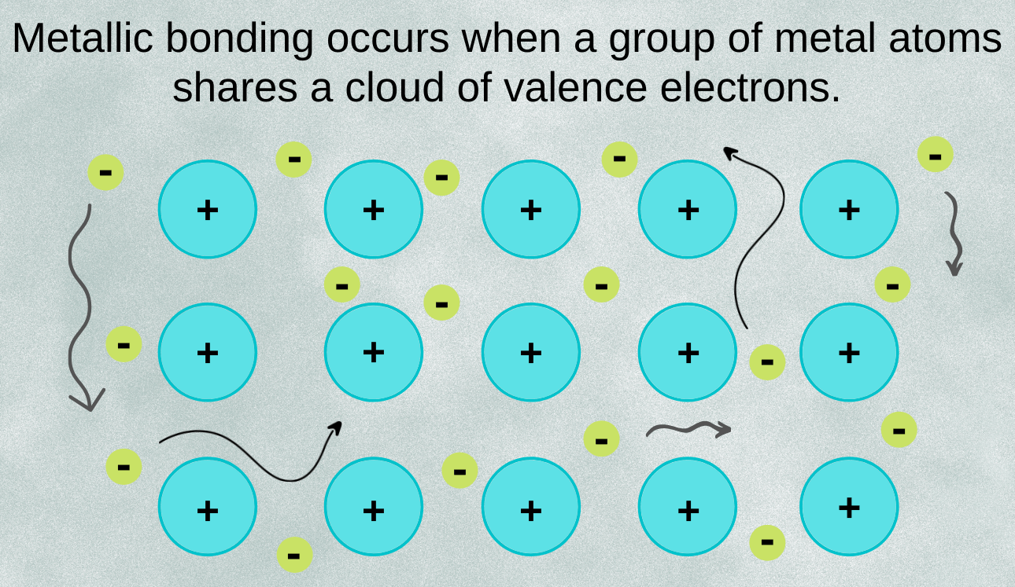
Metallic Bonding
Metallic bonding is a type of chemical bonding that arises from the electrostatic attractive force between conduction electrons (in the form of an electron cloud of delocalized electrons) and positively charged metal ions.

Slide 28
Always remember atoms are trying to complete their valence shell!
The number of electrons the atoms needs is the total number of bonds they can make.
Ex. … H? O? F? N? Cl? C?
one two one three one four

Slide 29
Draw Lewis Dot Structures
One can represent valence electrons from different atoms with the following symbols x, ,
H or H or H
x

Slide 30
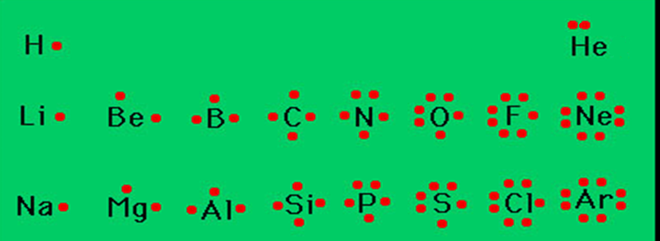
Drawing molecules (covalent) using Lewis Dot Structures
Symbol represents the nucleus and inner electrons of the atom
Dots represent valence electrons
Draw a valence electron on each side (top, right, bottom, left) before pairing them.

Slide 31
Covalent bonding
The atoms form a covalent bond by sharing their valence electrons to get a stable octet of electrons.(filled valence shell of 8 electrons)
Electron-Dot Diagrams of the atoms are combined to show the covalent bonds
Covalently bonded atoms form MOLECULES

Slide 32
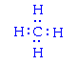
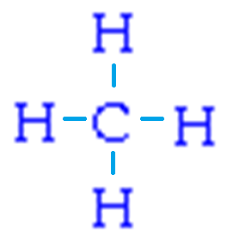
Methane CH₄
This is the finished Lewis dot structure
Every atom has a filled valence shell
OR

Slide 33
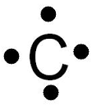


General Rules for Drawing Lewis Structures
All valence electrons of the atoms in Lewis structures must be shown.
Generally each atom needs eight electrons in its valence shell (except Hydrogen needs only two electrons and Boron, Aluminum need only 6).
Multiple bonds (double and triple bonds) can be formed by C, N, O, P, and S.
Central atoms have the most unpaired electrons.
Terminal atoms have the fewest unpaired electrons.

Slide 34
Lewis dot structures for multiple bonds in molecules
DOUBLE bond
atoms that share two e- pairs (4 e-)
O O
TRIPLE bond
atoms that share three e- pairs (6 e-)
N N
The number of shared pairs
one shared pair forms a single bond
two shared pairs form a double bond
three shared pairs form a triple bond

Slide 35
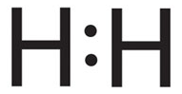
Lewis dot structures of molecules
H₂

Slide 36
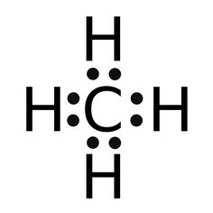
Lewis dot structures of molecules
CH₄

Slide 37
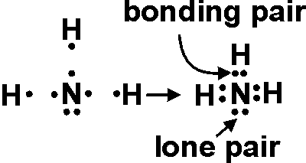
Lewis dot structures of molecules
NH₃

Slide 38
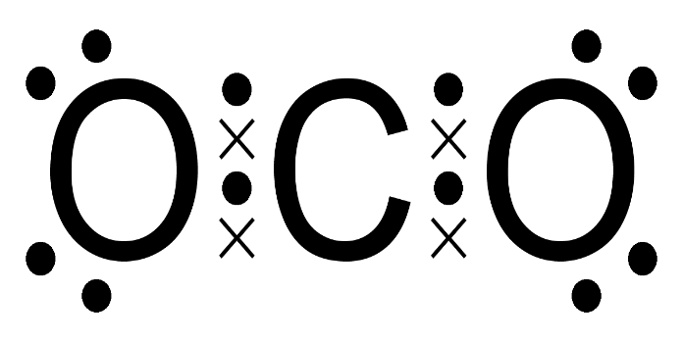
Lewis dot structures of molecules
CO₂
Carbon is the central atom

Slide 39
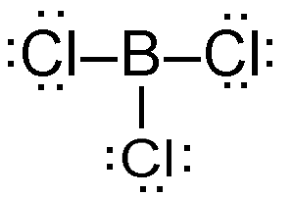
Lewis dot structures of molecules
BCl₃
boron only needs 6 valence electrons, it is an exception.

Slide 40
Bond Types based on bond polarity
3 Possible Bond Types:
Ionic
Non-Polar Covalent
Polar Covalent

Slide 41
Use Electronegativity Values to Determine Bond Types
Ionic bonds
Electronegativity (EN) difference > 2.0
Polar Covalent bonds
EN difference is between 0.50 and 1.99
Non-Polar Covalent bonds
EN difference is < .50
Electrons shared evenly in the bond

Slide 42
Electronegativity
Electronegativity:
a measure of an atom’s attraction for the electrons it shares with another atom in a chemical bond
Pauling scale
generally increases left to right in a row
generally increases bottom to top in a column

Slide 43
Ionic Character
“Ionic Character” refers to a bond’s polarity
In a polar covalent bond,
the closer the EN difference is to 2.0, the more POLAR its character
The closer the EN difference is to 0.50, the more NON-POLAR its character

Slide 44
Place these molecules in order of increasing bond polarity (1=least polar to 5 = most polar) polarity using the electronegativity values on your periodic table
HCl
CH₄
CO₂
NH₃
N₂
HF
3 EN difference = 0.9
2 EN difference = 0.4
4 EN difference = 1.0
3 EN difference = 0.9
1 EN difference = 0
5 EN difference = 1.9

Slide 45
Polar vs. Nonpolar MOLECULES
Sometimes the bonds within a molecule are polar and yet the molecule itself is non-polar

Slide 46
Nonpolar Molecules
Molecule is Equal on all sides
Symmetrical shape of molecule (atoms surrounding central atom are the same on all sides)
H
H
C
H
H

Slide 47
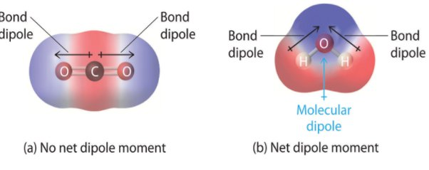
Nonpolar Molecules
Bond is polar (EN difference 0.9), but molecule is symmetrical on all sides, therefore non polar
Symmetrical shape of molecule (atoms surrounding central atom are the same on all sides)

Slide 48
Polar Molecules
Molecule is Not Equal on all sides
Not a symmetrical shape of molecule (atoms surrounding central atom are not the same on all sides)
Cl
H
C
H
H
Notes:
PER 5 11/14/2107

Slide 49
Polar Molecule
H
Cl
δ⁺
δ⁻
Unequal Sharing of Electrons
We show polarity by using the symbols δ+ and δ-, or by using an arrow with the arrowhead pointing toward the negative end and a plus sign on the tail of the arrow at the positive end

Slide 50
Non-Polar Molecule
Cl
Cl
Equal Sharing of Electrons

Slide 51
Polar Molecule
H
Cl
B
H
Not symmetrical

Slide 52
Non-Polar Molecule
H
H
B
H
Symmetrical

Slide 53
Water is a POLAR molecule ANY time there are unshared pairs of electrons on the central atom, the molecule is POLAR
O
H
H

Slide 54
Summary of polar vs. non-polar
EN = Electronegativity
BONDS
Non-polar Polar
EN difference EN difference
0 – 0.50 0.50 – 1.99
MOLECULES
Non-polar Polar
Symmetrical Asymmetrical
OR
Unshared e⁻s on Central Atom
EN difference 2 and above are ionic bonds

Slide 55
Bond Strength: Covalent Bonds
Stable molecules exist because covalent bonds hold the atoms together.
We measure the strength of a covalent bond by the energy required to break it, that is, the energy necessary to separate the bonded atoms.
Separating any pair of bonded atoms requires energy; the stronger a bond, the greater the energy required to break it.

Slide 56
Bond Strength: Covalent Bonds
The energy required to break a specific covalent bond in one mole of gaseous molecules is called the bond energy or the bond dissociation energy.
The bond energy for a diatomic molecule, D_{X–Y} , is defined as the standard enthalpy change for the endothermic reaction:
XY(g)⟶X(g)+Y(g) D_{X−Y} = ΔH°

Slide 57
Bond Strength: Covalent Bonds
For example, the bond energy of the pure covalent H–H bond, Δ_{H–H}, is 436 kJ per mole of H–H bonds broken:
H₂(g)⟶2H(g) D_{H−H} = ΔH°= 436kJ
Breaking a bond always require energy to be added to the molecule. Correspondingly, making a bond always releases energy.

Slide 58
Bond Strength: Covalent Bonds
The strength of a bond between two atoms increases as the number of electron pairs in the bond increases.
Generally, as the bond strength increases, the bond length decreases.
Thus, we find that triple bonds are stronger and shorter than double bonds between the same two atoms; likewise, double bonds are stronger and shorter than single bonds between the same two atoms.

Slide 59

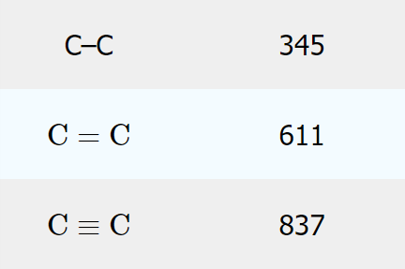
Bond Strength: Covalent Bonds
Triple bonds are stronger and shorter than double bonds
kJ / mol

Slide 60
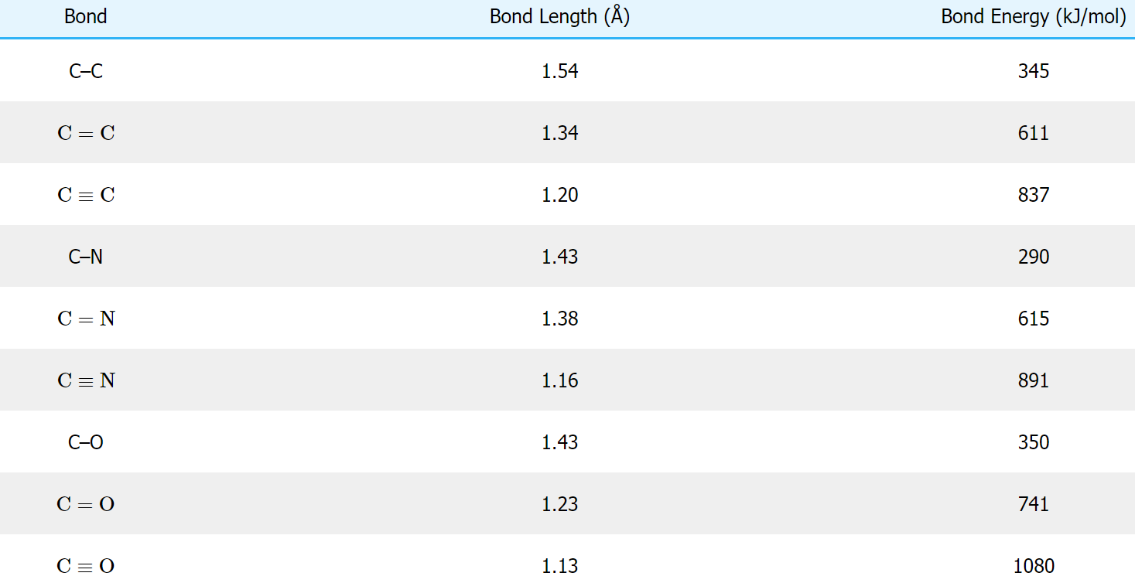
Bond Strength: Covalent Bonds

Slide 61
Bond Strength: Covalent Bonds
When one atom bonds to various atoms in a group, the bond strength typically decreases as we move down the group.
For example, C–F is 439 kJ/mol, C–Cl is 330 kJ/mol, and C–Br is 275 kJ/mol.

Slide 62
Resonance Structures
Some molecules have two or more chemically equivalent Lewis electron structures, called resonance structures.
Resonance structures are a set of two or more Lewis Structures that collectively describe the electronic bonding in a single polyatomic species including fractional bonds and fractional charges.

Slide 63
Resonance Structures
These structures are written with a double-headed arrow between them, indicating that none of the Lewis structures accurately describes the bonding but that the actual structure is an average of the individual resonance structures.
Resonance structures are used when one Lewis structure for a single molecule cannot fully describe the bonding that takes place between neighboring atoms relative to the empirical data for the actual bond lengths between those atoms.

Slide 64
Resonance Structures
The net sum of valid resonance structures is defined as a resonance hybrid, which represents the overall delocalization of electrons within the molecule.
A molecule that has several resonance structures is more stable than one with fewer.
Some resonance structures are more favorable than others.

Slide 65
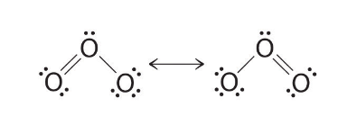
Resonance Structures (Examples)
Ozone ( O₃ )
The double-headed arrow indicates that the actual electronic structure is an average of those shown, not that the molecule oscillates between the two structures.

Slide 66
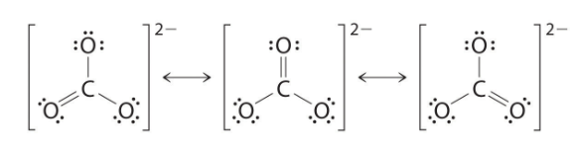
Resonance Structures (Examples)
The Carbonate ( CO₃²⁻ ) Ion
As with ozone, none of these structures describes the bonding exactly. Each predicts one carbon–oxygen double bond and two carbon–oxygen single bonds, but experimentally all C–O bond lengths are identical
The actual structure is an average of these three resonance structures.

Slide 67
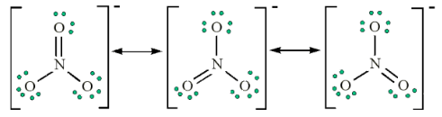
Resonance Structures (Examples)
The Nitrate ( NO₃⁻ ) ion
We would expect that the bond lengths in the NO₃⁻ ion to be somewhat shorter than a N – O single bond.

Slide 68

Resonance Structures (Examples)
The Nitrite ( NO₂⁻ ) ion
We would expect that the bond lengths in the NO₂⁻ ion to be somewhat shorter than a N – O single bond.

Slide 69
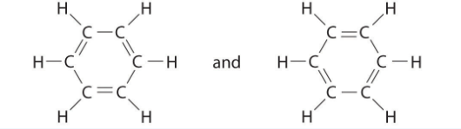
Resonance Structures (Examples)
Benzene:
Each structure has alternating double and single bonds, but experimentation shows that each carbon–carbon bond in benzene is identical, with bond lengths (139.9 pm) intermediate between those typically found for a C–C single bond (154 pm) and a C=C double bond (134 pm).

Slide 70
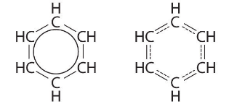
Resonance Structures (Examples)
Benzene:
We can describe the bonding in benzene using the two resonance structures, but the actual electronic structure is an average of the two.
The existence of multiple resonance structures for aromatic hydrocarbons like benzene is often indicated by drawing either a circle or dashed lines inside the hexagon

